Slide 1
Georgia’s Government:
LOCAL
GOVERNMENT
LOCAL GOVERNMENT
© Brain Wrinkles

Slide 2
Local Governments:
COUNTY &
CITY
© Brain Wrinkles

Slide 3
County: Origins
A county is an administrative subdivision of a state or territory.
Counties serve as ways for people to be represented in state government.
In 1777, Georgia’s Constitution established 8 counties.
Today, there are 159 counties in Georgia, as determined by the Constitution.
© Brain Wrinkles

Slide 4
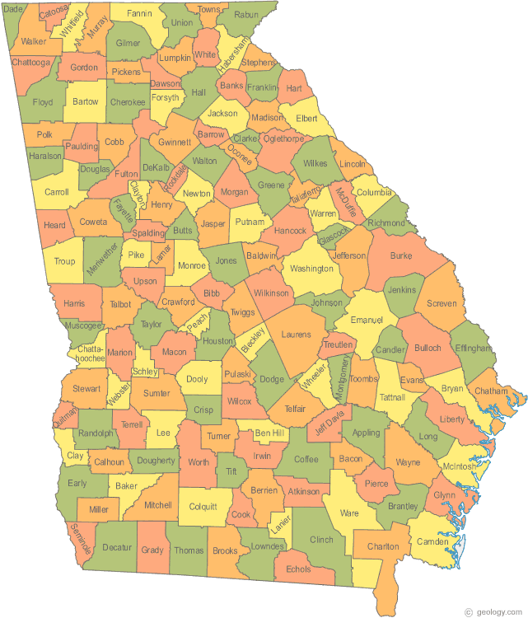
© Brain Wrinkles

Slide 5
County: Purpose
The original purpose of Georgia counties was to determine jurisdiction for state representatives.
Senate and House districts overlap county boundaries so that all counties are represented in the General Assembly.
Also, each county has a probate court, a magistrate court, and a juvenile court.
© Brain Wrinkles

Slide 6
County: Functions
Since the Constitution of 1983, the functions of county governments have increased.
Today, county government services include: running elections, building and maintaining roads, controlling licenses for cars and trucks, conducting local courts, and providing welfare and public assistance programs.
© Brain Wrinkles

Slide 7
County: Leaders
At the county level of government, Georgians vote for the county commissioner and/or board of commissioners.
There are four other elected county officials: sheriff, clerk of superior court, judge of probate court, and tax commissioner.
© Brain Wrinkles

Slide 8
City: Origins
Georgia has over 500 cities and towns (or municipalities).
These city governments have been granted charters by the General Assembly.
The charters outline the city’s form of government and define the city’s boundaries.
© Brain Wrinkles

Slide 9
City: Purpose
Early Georgia cities originated in areas that were significant trading hubs.
The purpose of city governments is to provide services that are not given by the county government.
© Brain Wrinkles

Slide 10
City: Functions
As county services have grown in Georgia, cities and counties have had to agree on who is providing which service to avoid duplication.
Some city government functions include: public transportation, police and fire protection, garbage collection, water services, public health services, libraries, etc.
© Brain Wrinkles

Slide 11
City: Leaders
Most city governments are led by a mayor and a city council, while some have city managers.
© Brain Wrinkles

Slide 12
Forms of:
CITY GOVERNMENT
© Brain Wrinkles

Slide 13
City Gov.
The forms of government of Georgia’s counties are standard across the state.
However, in cities, there are three main forms of government: weak mayor-council, strong mayor-council, and council-manager.
In all three forms, citizens elect members to the city council.
© Brain Wrinkles

Slide 14
Strong Mayor
The strong major-council form of city government divides power between an elected city council that acts as the legislative branch and elected mayor who serves as the city’s chief executive.
The council is responsible for passing city ordinances and the mayor is responsible for enforcing them.
The mayor has a great deal of power and influence over the council, and often has veto power over the council’s actions.
© Brain Wrinkles

Slide 15
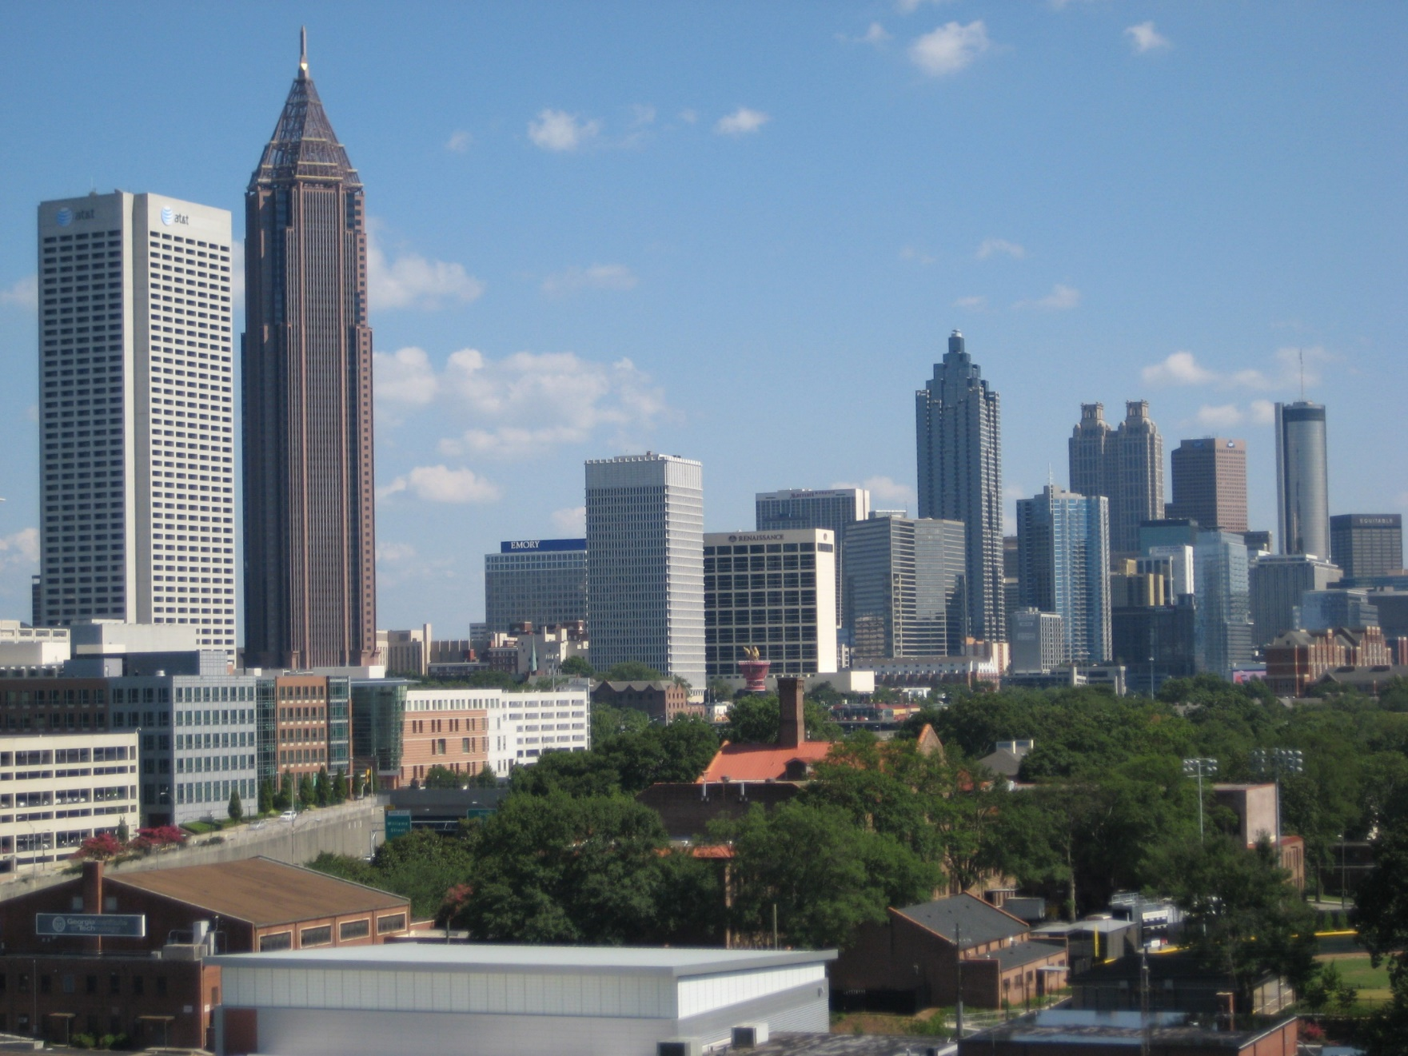
Atlanta has a strong mayor-council form of government.
© Brain Wrinkles

Slide 16
Weak Mayor
Some cities prefer not to allow their mayor to have so much power.
In the weak major-council form of city government, both the legislative and executive powers lie with the city council.
The mayor’s powers are very limited and he/she rarely has veto power.
Often, the mayor serves as figurehead who presides over meetings and engages in ceremonial duties.
© Brain Wrinkles

Slide 17
Council Manager
In the council-manager system, the citizens elect a city council that makes the laws and policies.
The council hires a city manager to oversee the day-to-day operations, determine the budget, and appoint heads of city departments.
Sometimes, such governments have a mayor, but he/she generally does little more than preside over council meetings and represent the city at events.
© Brain Wrinkles

Slide 18
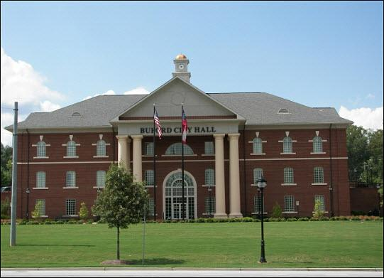
Buford, GA has a council-manager form of government.
© Brain Wrinkles

Slide 19
Functions of:
SPECIAL-PURPOSE GOVERNMENT
© Brain Wrinkles

Slide 20
i
Special-Purpose
The Georgia Constitution also allows special-purpose districts to be created.
These are set up by a city or county in order to meet specific needs of the people.
Special-purpose governments are administrative units which aim to accomplish a specific task.
They are funded by loans or user-fees instead of taxes.
© Brain Wrinkles

Slide 21
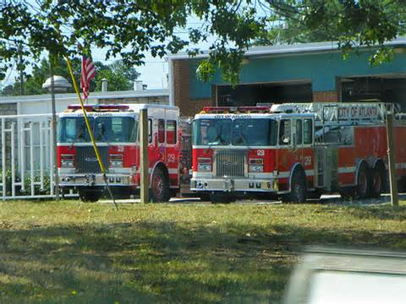
Community fire departments are special-purpose governments.
© Brain Wrinkles

Slide 22
i
Special-Purpose
Special-purpose governments can create jobs and increase business, maintain and rebuild the downtowns of cities, maintain and develop land for parks and recreation, manage housing options, etc.
For example, Georgia generally divides its public schools into districts, each of which is governed by a school board (special-purpose government).
Another example is MARTA, which runs Atlanta’s bus and train system, sets its transportation schedule, and determines the cost of fares.
© Brain Wrinkles

Slide 23
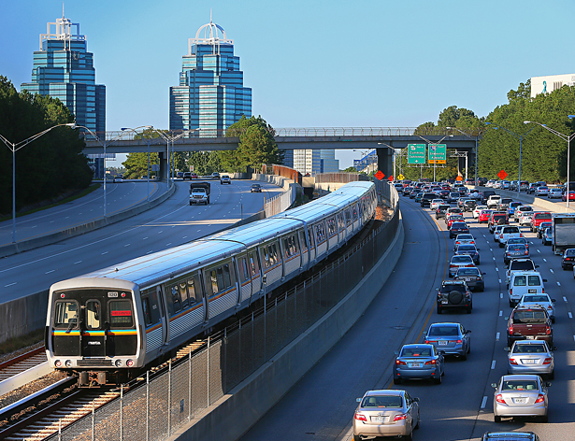
MARTA Train
© Brain Wrinkles

Slide 24
Role of
LOCAL GOVERNMENT
© Brain Wrinkles

Slide 25
Local Support
Counties work at the local government level with state agencies to administer state programs.
Every county in Georgia conducts local courts of law, voter registration, and elections.
They sell motor vehicle tags, validate wills, file property ownership records, run public assistance programs, and repair county roads.
All of these things help support Georgia’s state-run programs.
© Brain Wrinkles

Slide 26
Local Support
As Georgia’s population has grown, citizens have demanded more and more services from county’ governments.
Georgia’s Constitution of 1983 added extra powers for county governments in order to provide additional services desired by Georgians.
These local-level services strengthen the state’s programs as a whole and improve the quality of life for Georgia residents.
© Brain Wrinkles

