Slide 1
Georgia’s History:
Civil
Rights
SS8H11
© 2015 Brain Wrinkles

Slide 2
1940s - 1950s
State
Politics
SS8H11a
© 2015 Brain Wrinkles

Slide 3
White Primary
The white primary system helped white supremacists control Georgia’s politics because it only allowed whites to vote in statewide primary elections.
The white primary system completely cut African Americans out of the political process.
In 1944, the Supreme Court struck down a similar white primary system in Texas, ultimately leading to the end of Georgia’s white primary in 1946.
© 2015 Brain Wrinkles

Slide 4
1946 Race
1946 also saw one of the most controversial episodes in Georgia politics.
Eugene Talmadge was elected governor for the fourth time, but he died before he could take office.
Many of his supporters knew that he was ill, so they scratched his name off the ballot and wrote in his son’s name, Herman Talmadge.
The state legislature chose between the two people with the largest number of write-in votes, and Herman Talmadge won.
© 2015 Brain Wrinkles

Slide 5
1946 Race
Progressive Ellis Arnall, who was governor at the time, did not want Talmadge to win because he would continue his father’s harsh policies.
Arnall resigned so that lieutenant governor Melvin Thompson could take over.
Talmadge took the governor’s office by force and seized control of the Governor’s Mansion, while Thompson set up an alternate governor’s office in downtown Atlanta.
The Georgia Supreme Court finally stepped in and ruled that Thompson was to serve as acting governor until a special election could be held to settle the matter.
© 2015 Brain Wrinkles

Slide 6
Herman Talmadge
Like his father, Herman Talmadge ran a race based on white supremacy.
He served as Georgia's governor from 1948 to 1955 and was incredibly popular among the state’s white Democrats.
Talmadge made significant advances in public education during his time in office.
In 1956, Talmadge won a seat in the United States Senate, where he served until 1980.
© 2015 Brain Wrinkles

Slide 7
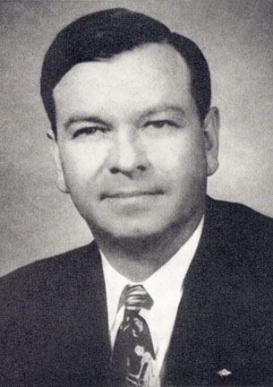
Herman Talmadge
© 2015 Brain Wrinkles

Slide 8
1956 State Flag
In 1956, the Georgia Assembly approved the state’s most controversial flag.
The 1956 flag greatly offended African Americans and progressive whites because two-thirds of it looked like a Confederate battle flag.
Most people believed the legislature’s new flag decision to be symbolic of Georgia’s resistance to the federal government’s integration laws.
The flag represented Georgia for 45 years until it was finally replaced in 2001.
© 2015 Brain Wrinkles

Slide 9
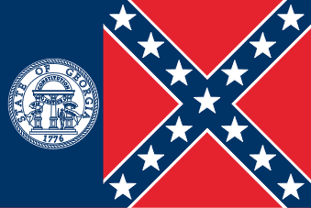
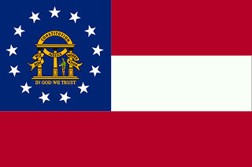
Present Flag
1956 to 2001 Flag
© 2015 Brain Wrinkles

Slide 10
1940s & 1950s:
Civil
Rights
SS8H11a
© 2015 Brain Wrinkles

Slide 11
Civil Rights
Throughout the US’ history, many African Americans were treated like second-class citizens, especially in the South.
They were forced to live in segregated housing, attend segregated movies, and use segregated facilities such as restrooms, water fountains, and waiting rooms.
During the Civil Rights Movement, African Americans fought against racial discrimination and segregation.
© 2015 Brain Wrinkles

Slide 12
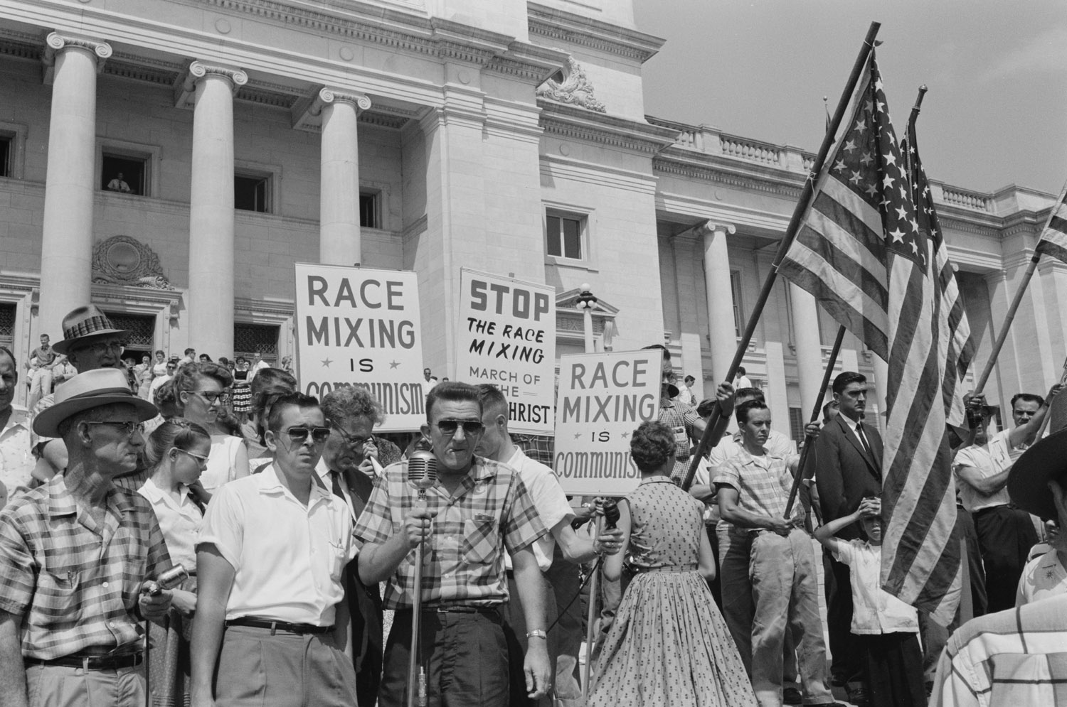
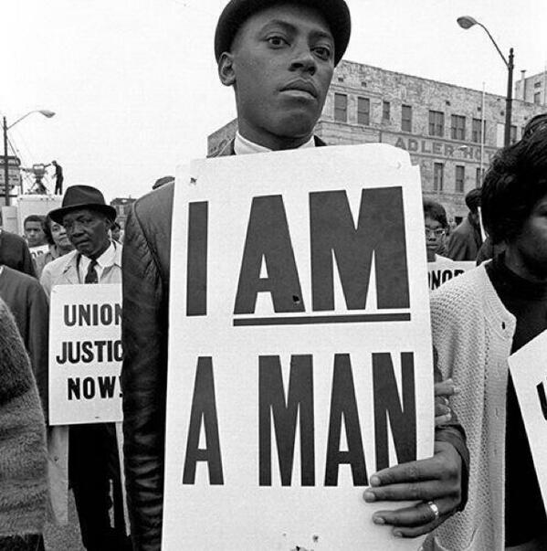
© 2015 Brain Wrinkles

Slide 13
Benjamin Mays
One of Georgia’s early influential voices was Benjamin Mays, the son of former slaves who grew up to be a very educated man.
Mays was a minister and educator who became president of Atlanta’s Morehouse College in 1940.
He spoke out against segregation and strongly believed that all human beings should be treated with respect and dignity.
© 2015 Brain Wrinkles

Slide 14
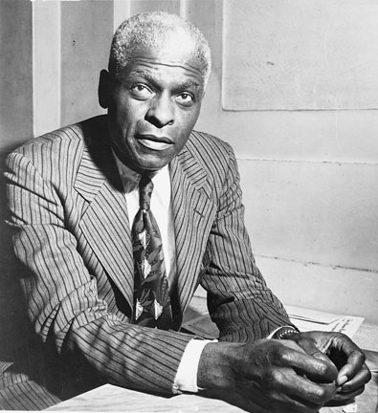
In 1936, Benjamin Mays went to India to meet with Mohandas Gandhi, where he learned of nonviolent protest.
© 2015 Brain Wrinkles

Slide 15
Benjamin Mays
Mays was a highly intelligent and influential man who became known for expressing his views on segregation during lectures attended by his students.
He preached to his students about the changes that needed to occur in social policies because racial injustices went against the United States’ democratic principles.
Mays also taught them to challenge the segregation laws that restricted their human rights.
© 2015 Brain Wrinkles

Slide 16
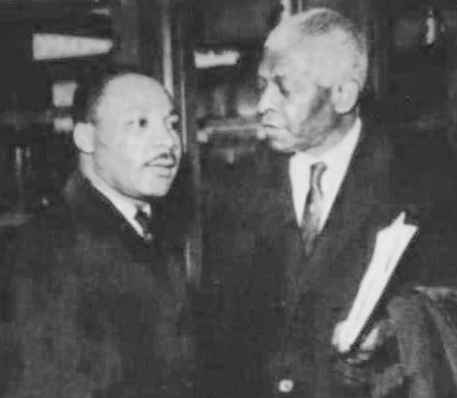
Benjamin Mays passed along his nonviolent ideas to his mentee, Martin Luther King, Jr.
© 2015 Brain Wrinkles

Slide 17
Martin Luther King, Jr.
Mays’ lectures had a tremendous impact on one of his students—Martin Luther King, Jr.
King graduated from Morehouse with a Ph.D. and became an ordained minister.
He became a national hero and the recognized leader of the Civil Rights Movement after successfully leading the Montgomery Bus Boycott.
The Boycott ended when the Supreme Court ordered Montgomery to desegregate their public transportation.
© 2015 Brain Wrinkles

Slide 18
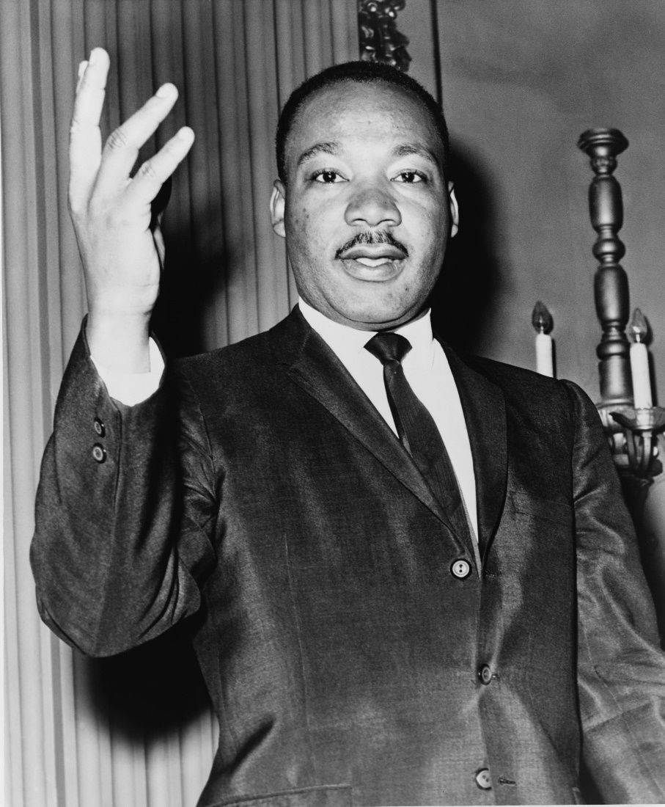
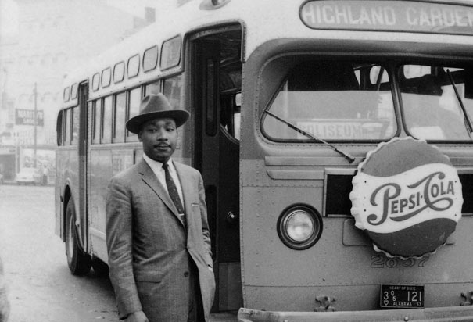
© 2015 Brain Wrinkles

Slide 19
Martin Luther King, Jr.
King was an extremely gifted man who preached nonviolent civil disobedience against unfair laws.
He believed that African Americans could gain their rights by protesting, but that the protests should be peaceful.
King formed a group called the Southern Christian Leadership Conference to lead anti-discrimination marches and protests throughout the South.
© 2015 Brain Wrinkles

Slide 20
Nonviolent Protests
King believed that African Americans would win their rights quicker if they refused to engage in violence.
Many African Americans and some whites held nonviolent marches and boycotts across the country.
At times, the nonviolent actions from civil rights workers received violent reactions from white people.
As people around the nation saw peaceful protestors being beaten by angry mobs and policemen, the movement gained support.
© 2015 Brain Wrinkles

Slide 21
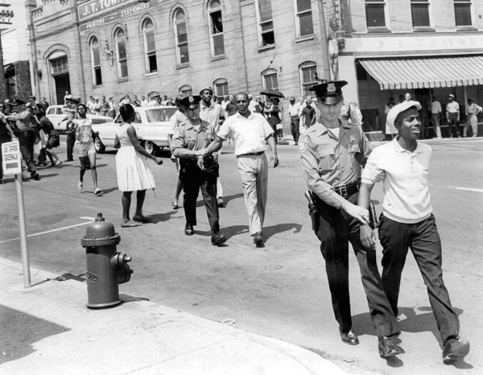
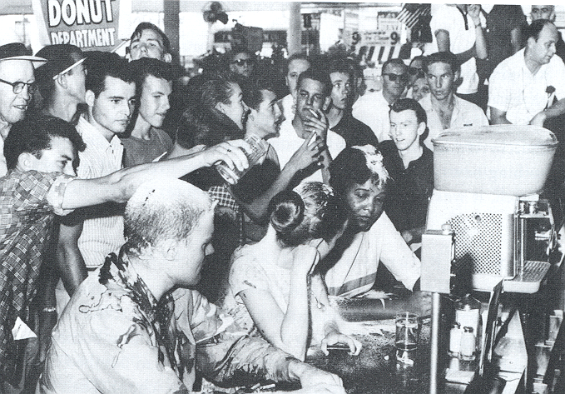
© 2015 Brain Wrinkles

Slide 22
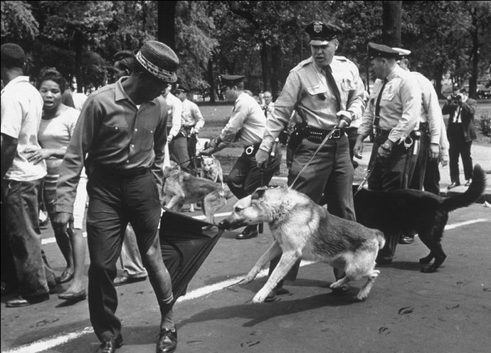
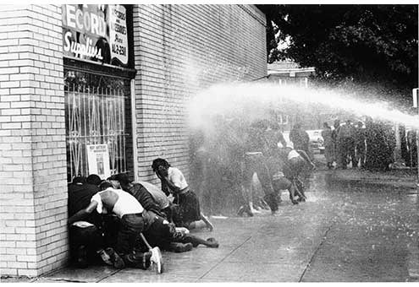
© 2015 Brain Wrinkles

Slide 23
Schools
Schools were another place where blacks and whites were segregated.
In 1954, Oliver Brown sued the board of education in Topeka, Kansas because the schools were segregated.
His third grade daughter, Linda, had to travel one mile to get to her black school, even though the white school was a lot closer.
© 2015 Brain Wrinkles

Slide 24
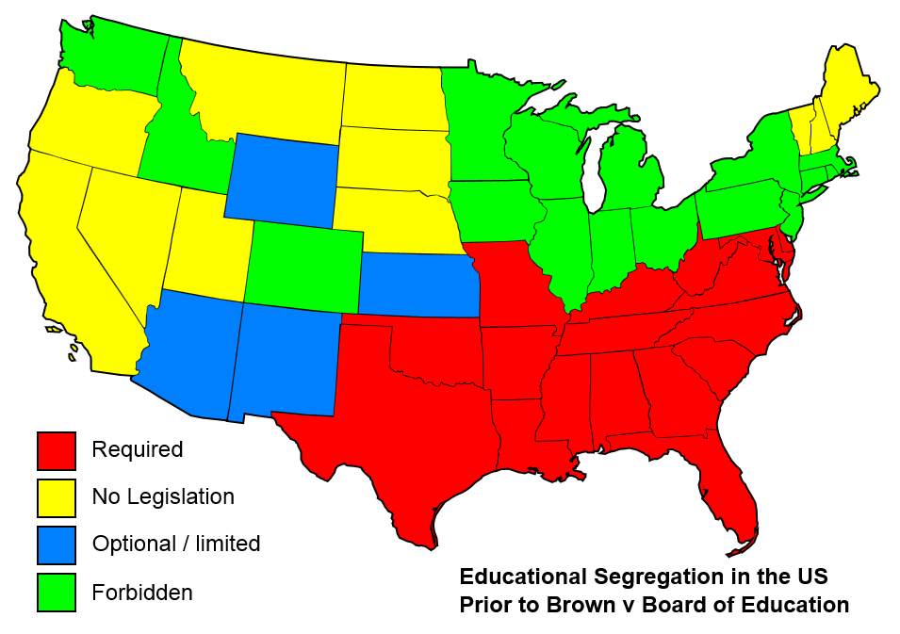
© 2015 Brain Wrinkles

Slide 25
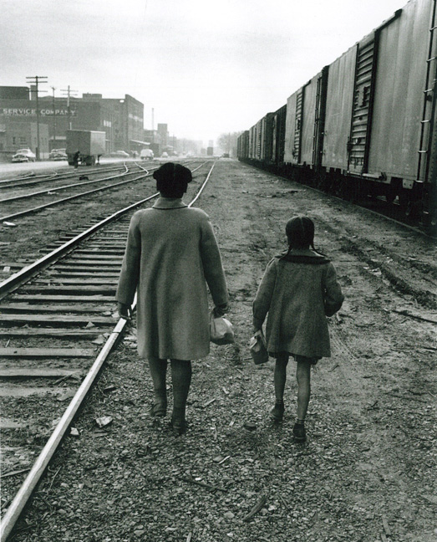
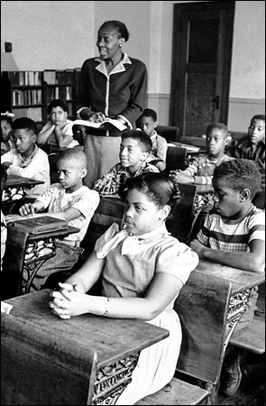
Linda Brown
© 2015 Brain Wrinkles

Slide 26
Thurgood Marshall
Linda Brown’s lawyer was Thurgood Marshall.
He argued the case before the U.S. Supreme Court that having separate schools violated the 14th Amendment to the Constitution.
© 2015 Brain Wrinkles

Slide 27
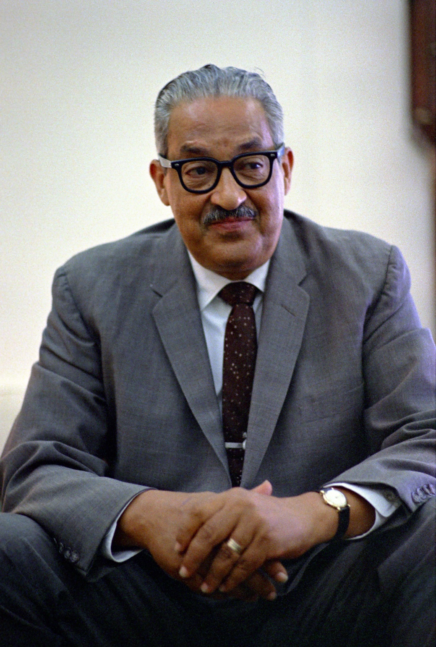
In 1967, Thurgood Marshall became the first African American Supreme Court Justice.
© 2015 Brain Wrinkles

Slide 28
Brown v. BOE
The US Supreme Court heard the case Brown v. Board of Education.
In 1954, the Supreme Court handed down a unanimous decision that greatly impacted Georgia and the rest of the South.
The court ruled that segregation was unconstitutional, and public schools across America began to integrate.
© 2015 Brain Wrinkles

Slide 29
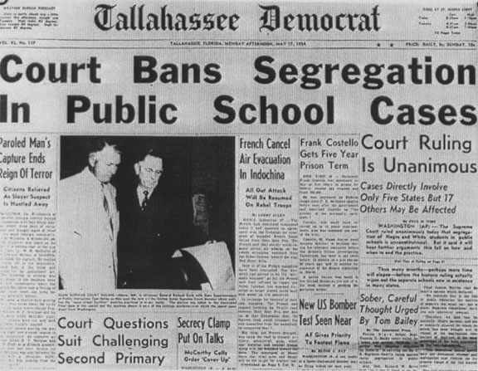
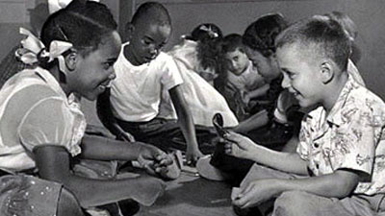
© 2015 Brain Wrinkles

Slide 30
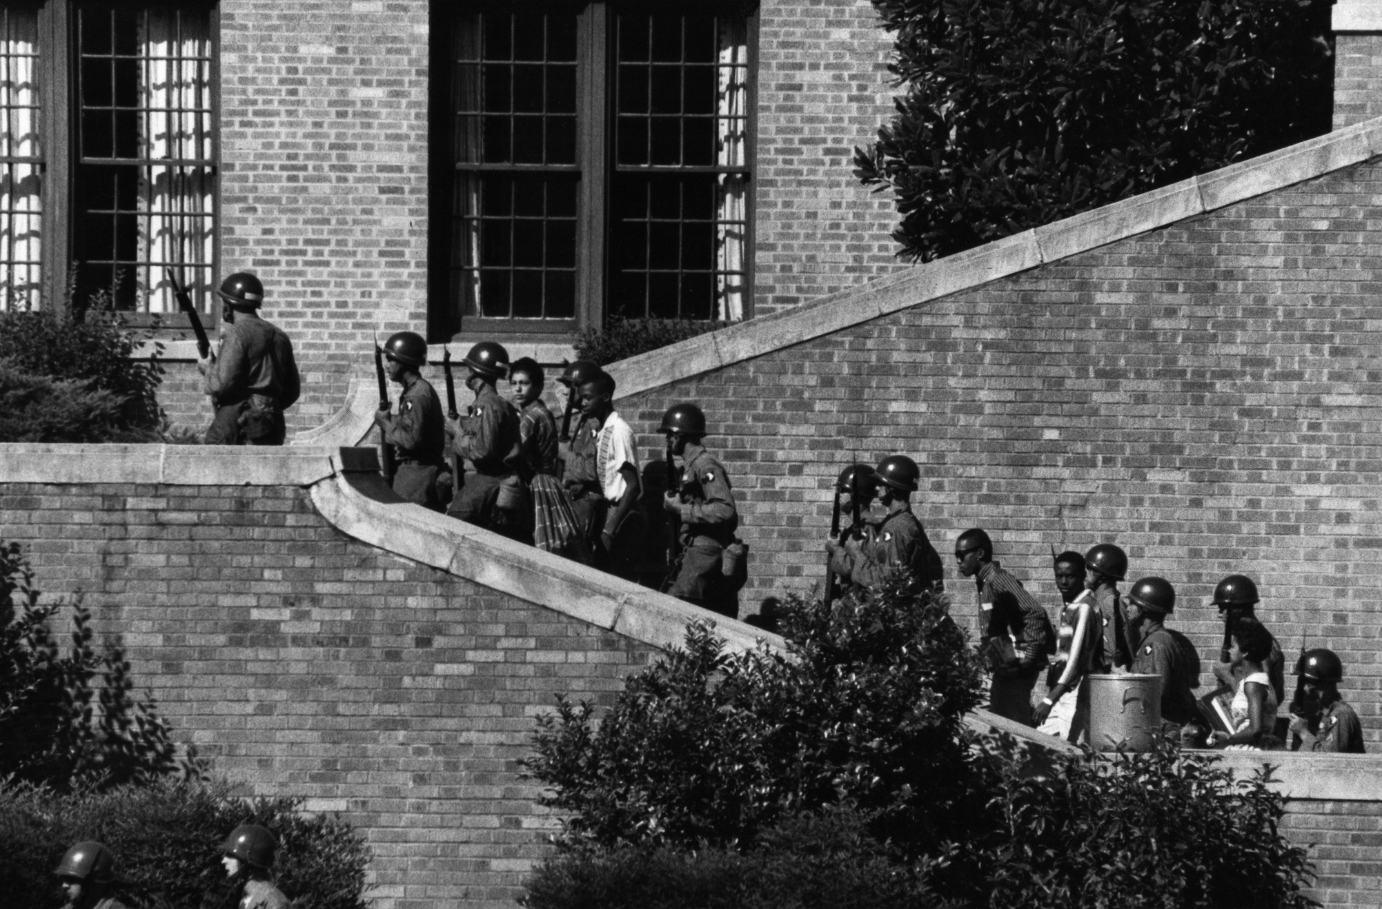
The National Guard escorts 9 African American students to their high school in Little Rock, Arkansas.
© 2015 Brain Wrinkles

Slide 31
Brown v. BOE
This case overturned the earlier 1896 Plessy v. Ferguson case that declared the “separate but equal” doctrine.
Even though all 9 of the justices ruled that any separation would not be equal, many southern states refused to segregate their schools.
Georgia’s governor, Herman Talmadge, strongly opposed the decision and encouraged Georgia’s legislature to rebel against the ruling.
© 2015 Brain Wrinkles

Slide 32
1960s & 1970s:
Civil
Rights
SS8H11bc
© 2015 Brain Wrinkles

Slide 33
Sibley Commission
After schools were forced to segregate by law in 1954, Georgia refused to cooperate.
In 1960, a commission was formed by Atlanta banker John Sibley that held public hearings to see how Georgians felt about integration.
The Sibley Commission found that 2 out of 3 Georgians would rather see schools closed that integrated.
As a result, the commission recommended that each local district decide the desegregation matter for itself.
© 2015 Brain Wrinkles

Slide 34
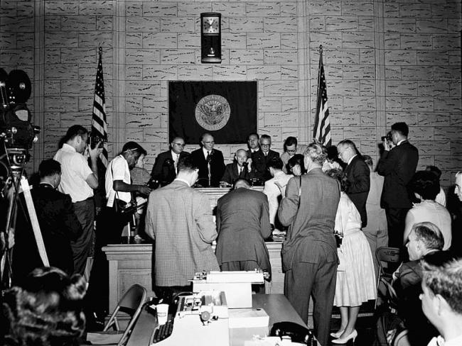
The Sibley Commission allowed local districts to make their own decision regarding desegregation, which made the process of integration very slow.
© 2015 Brain Wrinkles

Slide 35
UGA Integration
African American students Charlayne Hunter and Hamilton Holmes both applied several times to the University of Georgia.
Each time, their applications were denied because the university was “full”.
They took their case to court and the school was integrated in 1961 under an order by the US District Court in Athens.
When they entered, they were treated harshly by the student population and an angry crowd threw bricks through Hunter’s dorm window.
© 2015 Brain Wrinkles

Slide 36
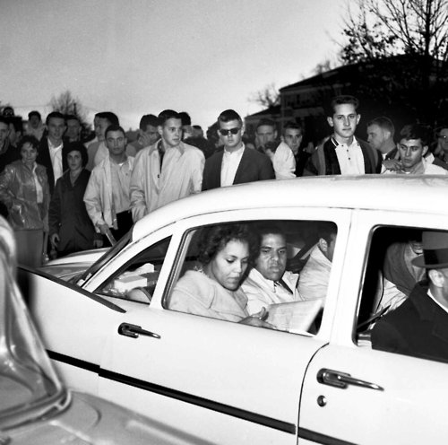
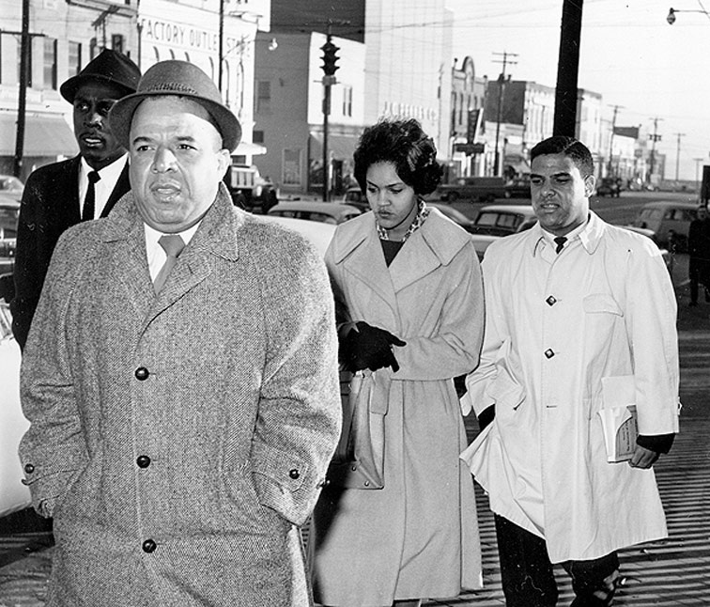
© 2015 Brain Wrinkles

Slide 37
UGA Integration
Both Hunter and Holmes graduated and went on to have very successful careers.
Holmes was a surgeon and Hunter is a writer/journalist.
High school integration soon followed throughout the state.
Today, there is a Holmes/Hunter academic building on UGA’s campus in their honor.
© 2015 Brain Wrinkles

Slide 38
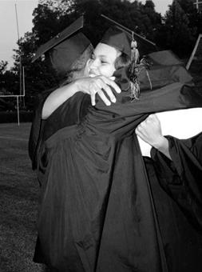
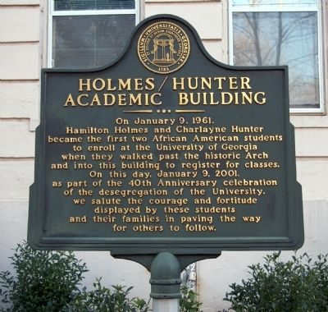
© 2015 Brain Wrinkles

Slide 39
SNCC
By the 1960s, the Civil Rights Movement was well underway and was gaining fast momentum.
King’s strategy of peaceful protest was adopted by a group of college students who formed the Student Non-Violent Coordinating Committee (SNCC) in 1960.
SNCC used sit-ins at lunch counters where they refused to move in order to boycott businesses that wouldn’t serve blacks.
SNCC also helped promote voter registration throughout the South.
© 2015 Brain Wrinkles

Slide 40
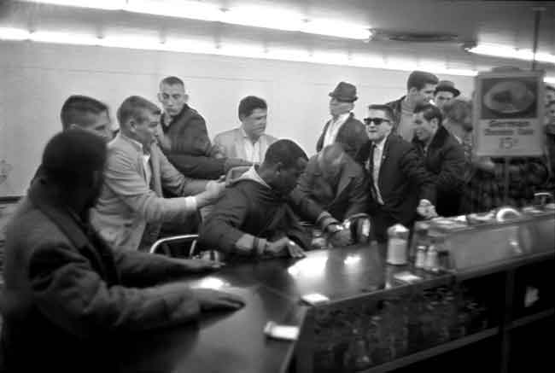
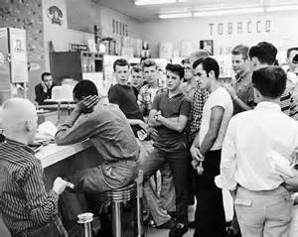
© 2015 Brain Wrinkles

Slide 41
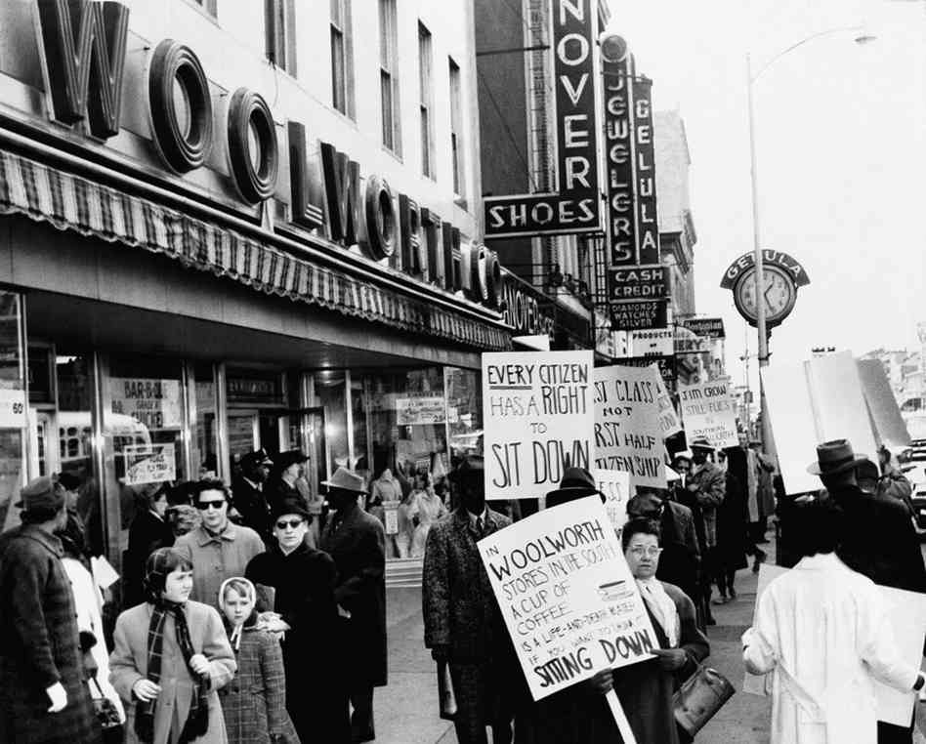
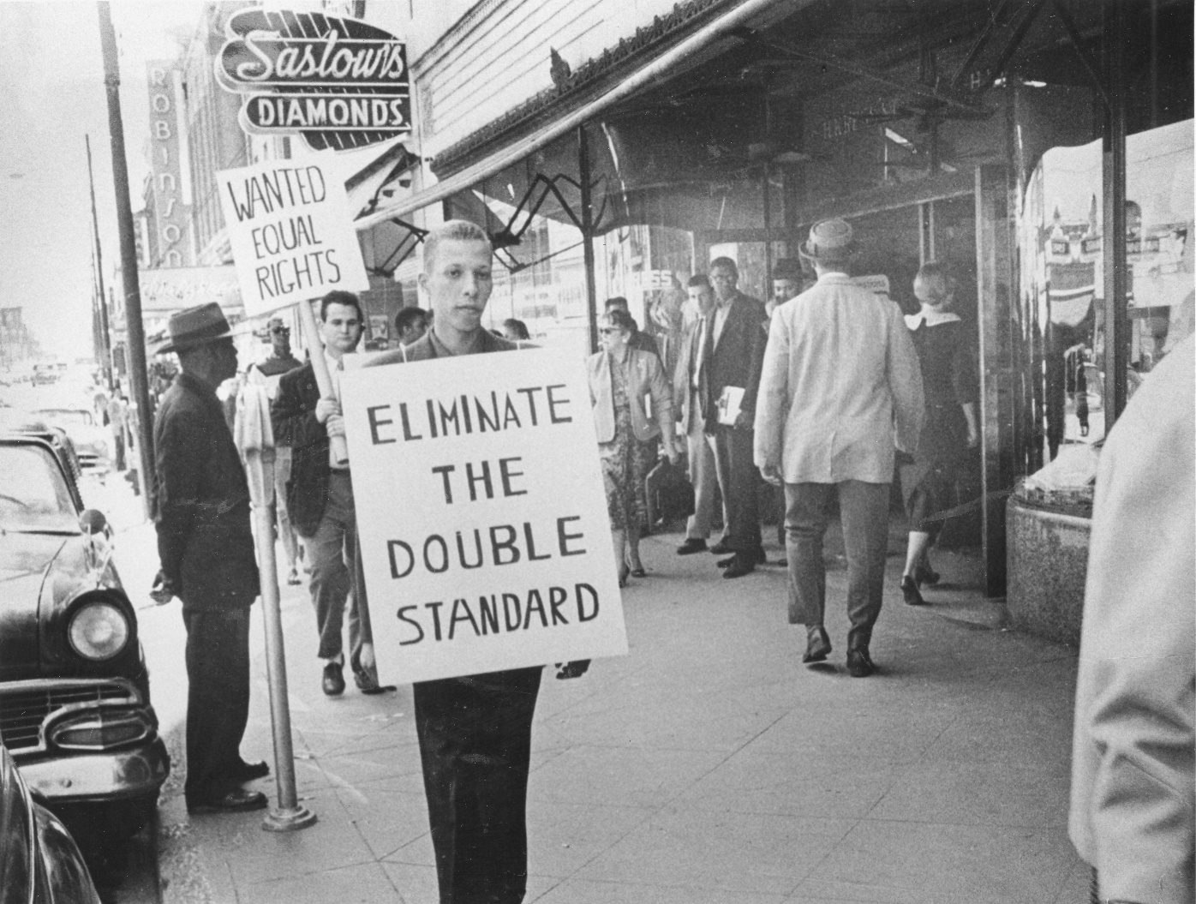
© 2015 Brain Wrinkles

Slide 42
Albany Movement
From fall 1961 to summer 1962, a desegregation movement involving the NAACP and SNCC took place in Albany, Georgia.
The movement’s goal was to end all types of segregation in Albany (transportation, schools, libraries, hospitals, restaurants, juries, etc.) through mass protests, sit-ins, and boycotts.
The police wanted to avoid negative publicity, so they arrested over 500 protestors.
© 2015 Brain Wrinkles

Slide 43
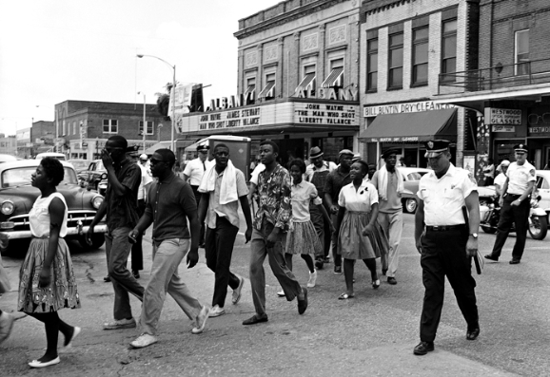
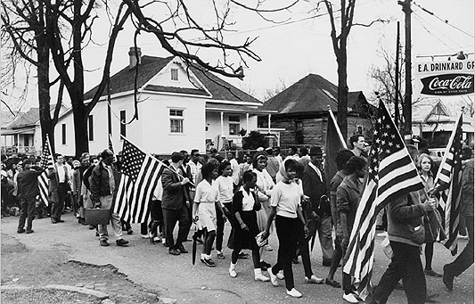
© 2015 Brain Wrinkles

Slide 44
Albany Movement
Martin Luther King, Jr. came to Albany to lend his support and bring national attention to the cause; however, he was also arrested.
Desegregation efforts failed in Albany, and King said it was because the groups tried to do too many things, instead of focusing on one aspect of segregation.
It was considered more of a learning experience than a success, but the city did eventually desegregate.
© 2015 Brain Wrinkles

Slide 45
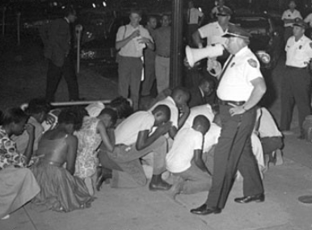
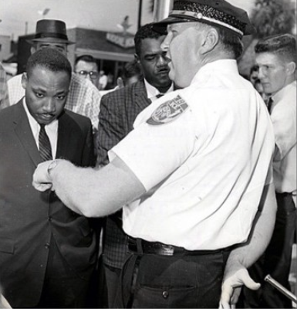
© 2015 Brain Wrinkles

Slide 46
March on Washington
In 1963, Martin Luther King, Jr. led more than 250,000 people on a civil rights march in Washington, D.C.
They called on President Kennedy and Congress to pass a law that guaranteed equal rights and quality education for all citizens.
King gave his famous “I Have a Dream” speech at the gathering, inspiring Americans to strive for a world where black and white children could play together in peace.
© 2015 Brain Wrinkles

Slide 47
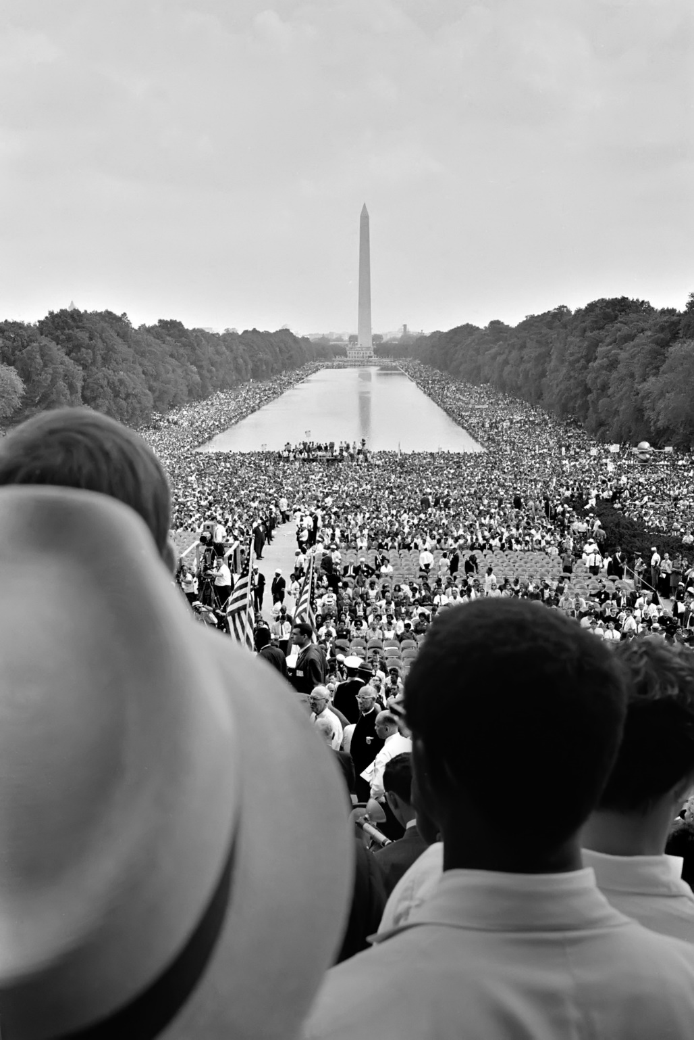
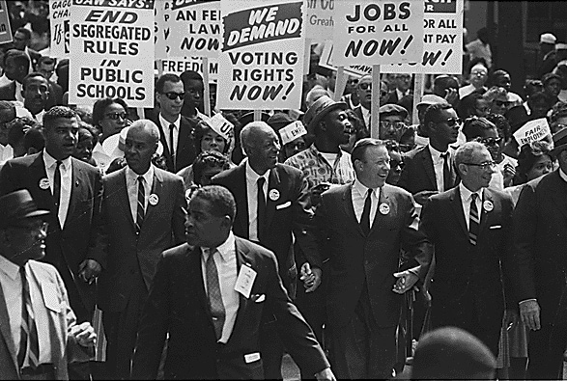
© 2015 Brain Wrinkles

Slide 48
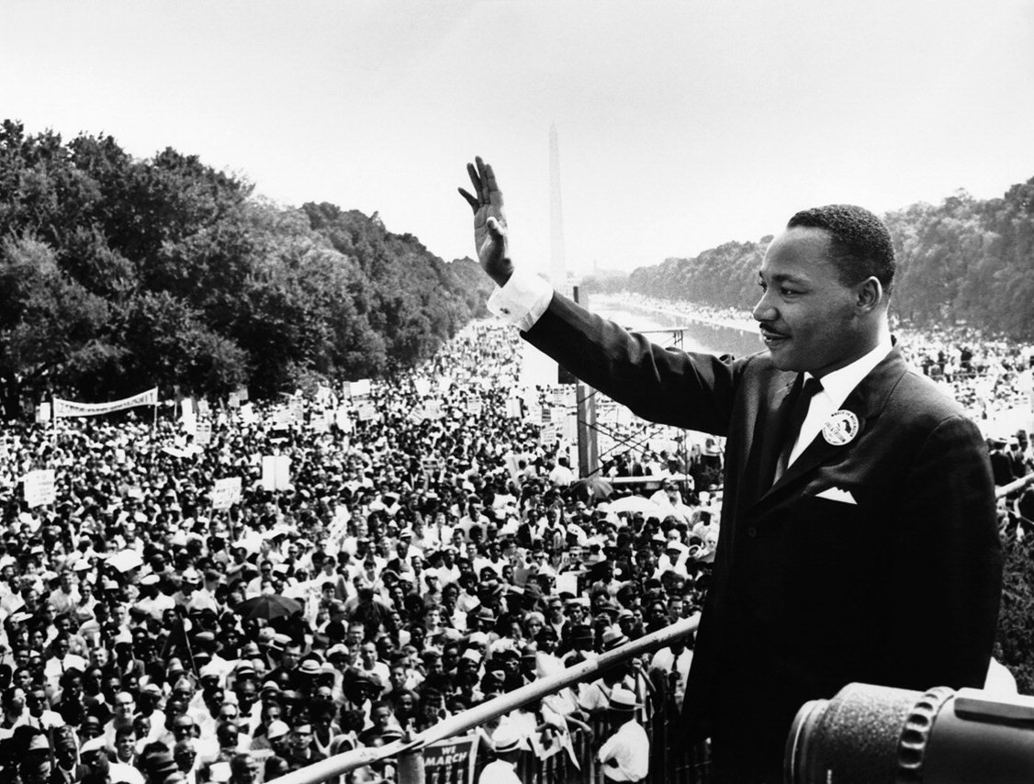
“I have a dream that my four little children will one day live in a nation where they will not be judged by the color of their skin but by the content of their character.”
Martin Luther King, Jr.
© 2015 Brain Wrinkles

Slide 49
Civil Rights Act
The March on Washington got the government’s attention and Congress soon passed the Civil Rights Act in 1964.
This law banned discrimination against any American because of that person’s race, color, or religion.
The law enforced the desegregation of public places.
It also said that people of all races, male and female, should have the equal opportunity to get a job.
© 2015 Brain Wrinkles

Slide 50
Lester Maddox
Lester Maddox became a public figure when he chose to close his Atlanta restaurant rather than comply with the Civil Rights Act and serve African Americans.
In 1966, he was elected as Georgia’s governor, despite being a strict segregationist.
Maddox surprised many people by hiring more African Americans into office than any governor before him.
© 2015 Brain Wrinkles

Slide 51
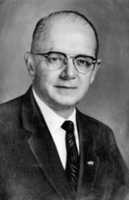
Lester Maddox
© 2015 Brain Wrinkles

Slide 52
Lester Maddox
Maddox also integrated the Georgia State Patrol and GBI.
As governor, he supported prison reform and increased spending for Georgia’s universities.
Maddox also started “People’s Day”, a monthly event where average citizens could come talk to him in the Governor’s office.
He kept representatives nearby to help the people solve their problems.
© 2015 Brain Wrinkles

Slide 53
Maynard Jackson
In 1973, Maynard Jackson made history when he was elected as Atlanta’s first African American mayor.
As mayor, Jackson made sure that minority businesses received a fair share of city contracts, often upsetting established white business owners.
Under his leadership, MARTA (Atlanta’s mass transit system) began running and Hartsfield Airport added a new international terminal that helped the economy.
The city of Atlanta added his name to the airport in 2003: Hartsfield-Jackson Airport.
© 2015 Brain Wrinkles

Slide 54
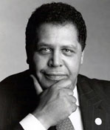
Maynard Jackson
© 2015 Brain Wrinkles

Slide 55
Andrew Young
Andrew Young became well known as a civil rights activist and aide to Martin Luther King, Jr.
In 1972, he won a seat in Congress and was Georgia’s first African American representative to the House since Reconstruction.
In 1977, President Carter appointed Young to be America’s ambassador to the United Nations.
In 1981, he succeeded Jackson as Atlanta’s mayor.
© 2015 Brain Wrinkles

Slide 56
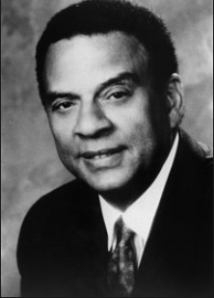
Andrew Young
© 2015 Brain Wrinkles

Slide 57
Andrew Young
Young served two successful terms as mayor, where he increased international investment in the city and brought the 1988 Democratic Convention to Georgia.
He ran for governor in 1990, but lost to Zell Miller.
Young played a key role in bringing the 1996 Olympic Games to Atlanta.
© 2015 Brain Wrinkles

