Slide 1
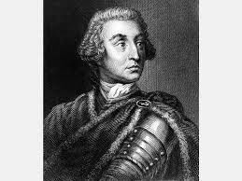
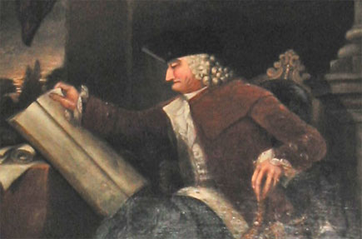
Image 1
Image 2
Compare and contrast these two men by completing the visual text analysis page.

Slide 2
This is also James Oglethorpe. Based on what you have learned about him today, why would
they portray him in a painting looking like this?

